Slide 1


ShARc: Shape and Appearance Recognition
for Person Identification In-the-wild
Haidong Zhu, Wanrong Zheng, Zhaoheng Zheng and Ram Nevatia
University of Southern California
IEEE/CVF Winter Conference on Applications of Computer Vision (WACV) 2024
Waikoloa, Hawaii
January 4th, 2023
Notes:
Hello everyone, my name is Haidong Zhu and I’m honor to present our paper, ShaRC, shape and appearance recognition forperson identifaion in the wild. This paper was finished with my lambmates Wanrong Zheng, Zhaoheng Zheng and my my advisor, Professor Ram Nevatia.

Slide 2
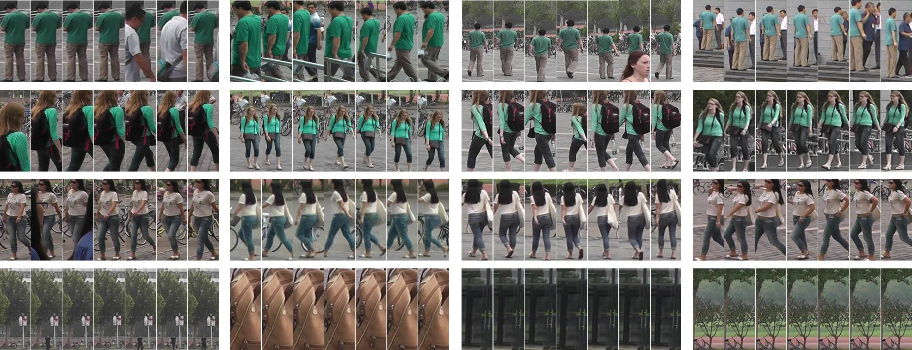
Task Definition
Person identification in-the-wild:
Recognize a person’s identity with a period of video
Zheng, Liang, et al. "Mars: A video benchmark for large-scale person re-identification." ECCV, 2016.
Notes:
In this paper we focus on video-based person identification, or re-identification with possible clothes changing, termed as in-the-wild. Person identification in the wild is to find the corresponding identity of the person with a sequence of RGB frames in a gallery.

Slide 3
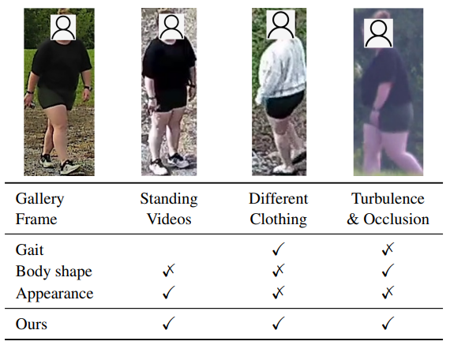
Challenges and Motivation
Challenges
Different activities and outfits
A single modality can handle some of the cases, but not all of them
Motivation
We separate the recognition to pose/shape with appearance, combining strengths from different modalities
Notes:
To recognize a person’s identity under a unconstrained condition, we have several possible challenges, including the possible change of outfits and different activities, as well as turbulence and occlusion. Some existing works are focusing on some specific pattern for recognizing the person, such as the appearance or gait, as the single guidance for recogntizing the person, which is insufficient for all cases. However, we note that each modality has their specific strength in distinguishing the person from others. Motivated by this, we build a multimodal person identification system by separating the recognition to appearance and pose with shape. In this way, we are able to combine the different strengths from different modalities together for the final network.

Slide 4
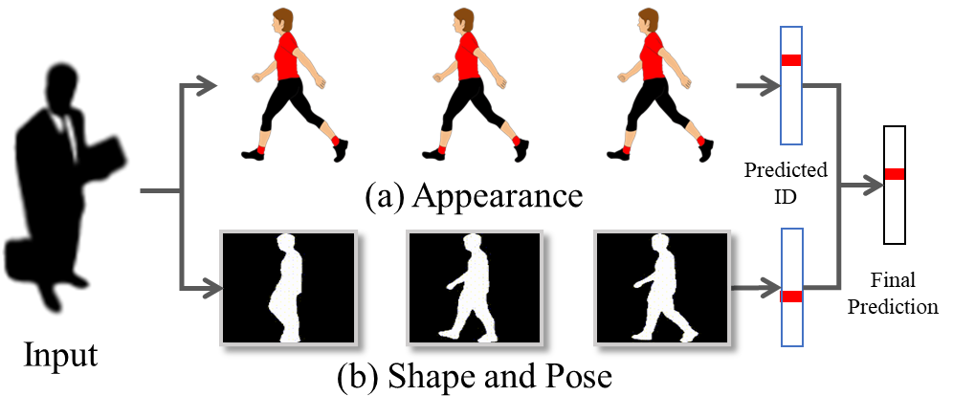
Method Overview
Two branch design for shape and appearance recognition
Appearance branch - appearance of the frames in the video
Shape and pose branch - gait motion and body shape recognition
Predicted scores are aggregated after two branches
Notes:
Here is a quick overview of our proposed method. Given an sequence of input video, which is the track let of the person, we decompose the final recognition to two different branches. The first branch is for appearance, which is focusing on the appearance of the person for final recognition, and we also have a pose and shape branch in parallel to it, for providing extra information when the appearance is changing or not reliable. Instead of fusing these two features together, we first directly match each feature to their corresponding representation in the gallery and generate the predict id with their corresponding socres, and then we combine these scores together as the final representation and prediction. In this way, the prediction of different branches are not interfere with each other and the corresponding modality can give their score based on their own knowledge.

Slide 5
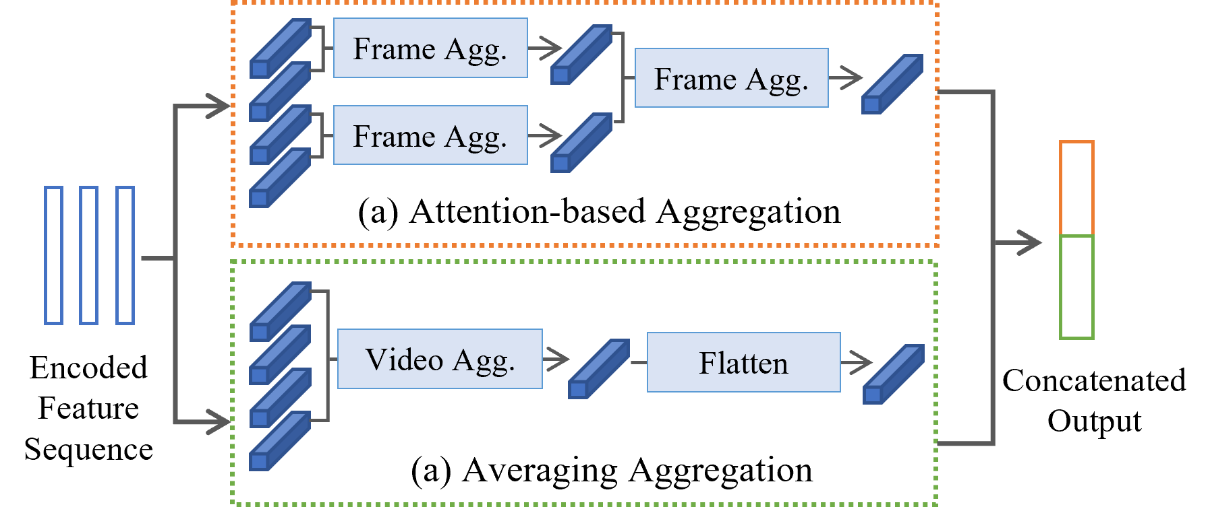
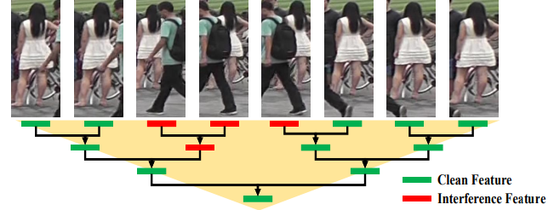
Methods
Appearance-based recognition (AAE)
Attention-based aggregation for one and two consecutive frames ^{[1]}
Averaging of the appearance for all the frames in the video
[1] Yingquan Wang, et al. "Pyramid spatial-temporal aggregation for video-based person re-identification." In ICCV, pp. 12026-12035. 2021.
Notes:
So here is a more detailed of our two branch methods. For appearance based recognition, we include two different ways for aggregating the features across different frames, attention based aggregation, and averaging aggregation. The attention based aggregation is to follow the Pyramid Spatial Tempral aggragaion and combine the two neighbor featues at a time, until we get the last layer for the final feature, and the average aggregation is simply averaging all the features across different frames, which can provide a more holistic understanding and avoid overfitting on a small part of area. The averaged feature is then flattened to exaggerate the difference for the small values around 0 point and avoid punishing on the large values far away from 0. More details of this section can be found in our paper.

Slide 6
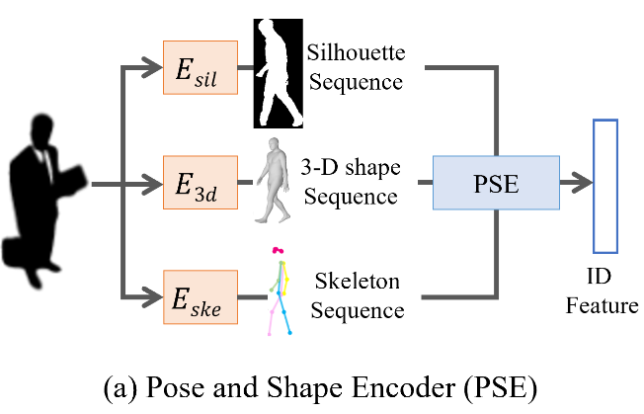
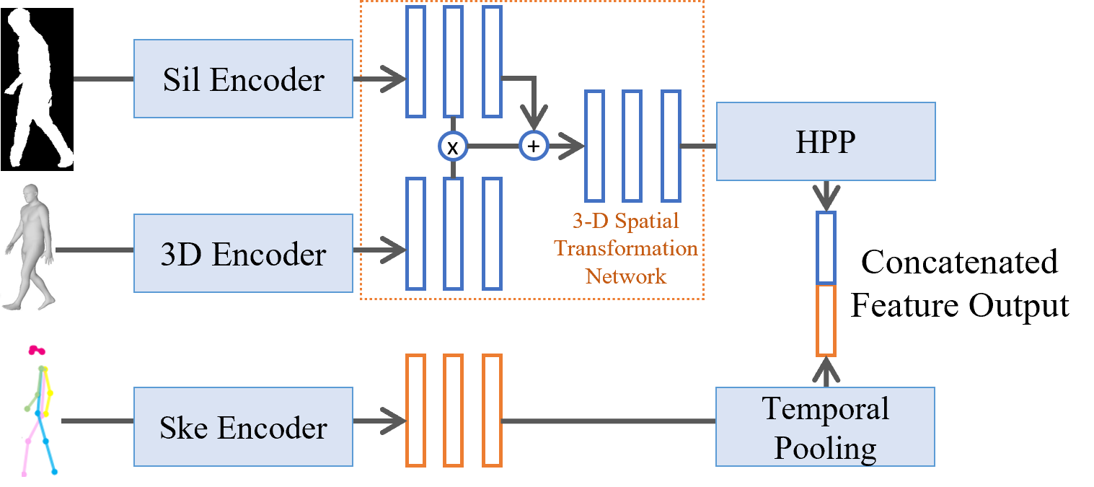
Methods
Pose and shape based recognition (PSE)
Three encoders for silhouettes, 3-D body shape and skeletons
Silhouettes and body shape are framewise combined
Skeletons are combined after temporal pooling

Slide 7
Experiments and Results
Datasets:
CCVID
75 IDs for training, 151 for inference
MEVID
104 IDs for training, 54 for inference
BRIAR
407 IDs for training, 642 for inference
Metrics
Accuracy for all three and mAP for MEVID and CCVID

Slide 8
Performance on CCVID
 | General |  | Clothes Changes
Method | Rank 1 | mAP | Rank 1 | mAP
GaitNet | 62.6 | 56.5 | 57.7 | 49.0
GaitSet | 81.9 | 79.2 | 71.0 | 62.1
CAL | 82.6 | 81.3 | 81.7 | 79.6
ShARc | 89.8 | 90.2 | 84.7 | 85.2

Slide 9
Performance on MEVID and BRIAR
MEVID
BRIAR
Method | Rank 1 | Rank 20
PSTA | 46.2 | 77.8
ARGL | 48.4 | 77.9
Attn-CL | 42.1 | 73.1
Attn-CL+RR | 46.5 | 71.8
CAL | 52.5 | 80.7
ShARc | 59.5 | 82.9
Method | Rank 1 | Rank 20
GaitGL | 15.6 | 45.6
GaitRef | 17.7 | 50.2
PSTA | 33.6 | 67.3
Attn-CL+RR | 27.6 | 61.8
CAL | 34.9 | 71.4
ShARc | 41.1 | 83.0

Slide 10
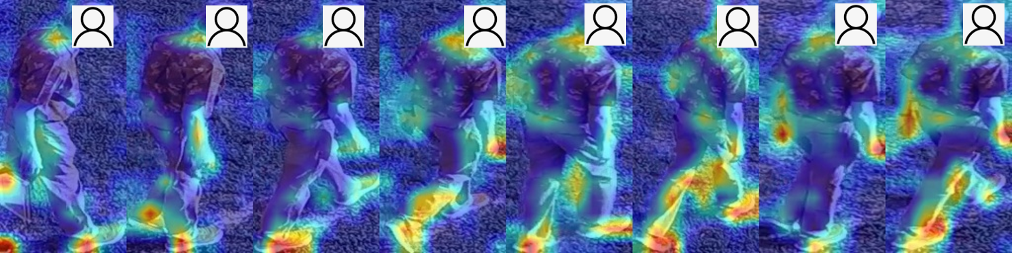
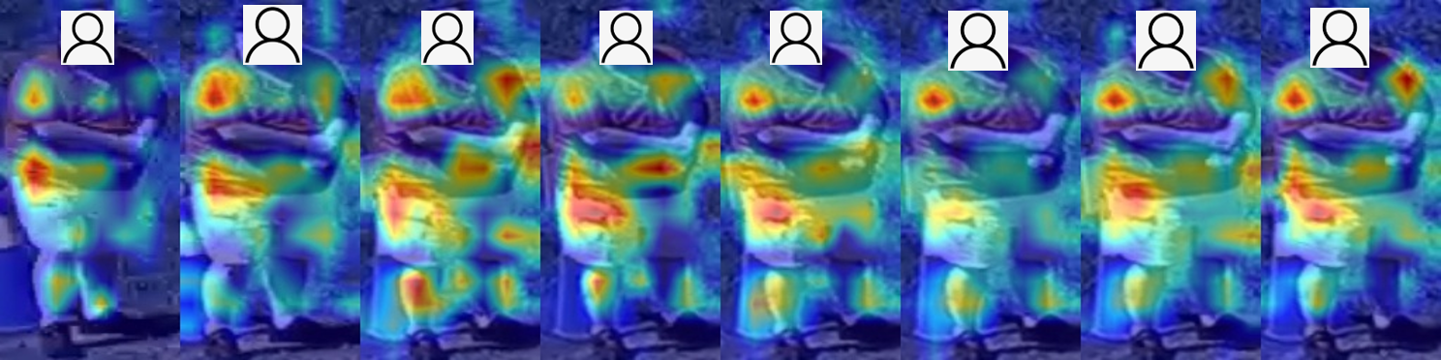
Attention Visualization
Visualization of attention produced by the model for different activities
Walking
Standing

Slide 11


Thank you!

